Slide 1
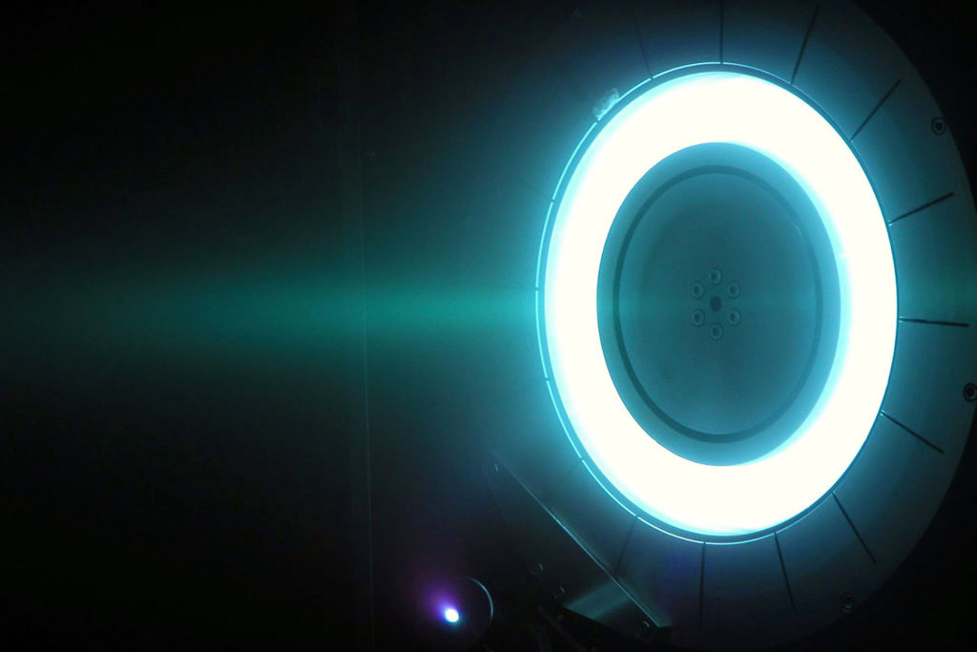
Ion engine - engine of the future

Slide 2
1.Annotation
Relevance of the work:Ion engines are a next-generation technology that can deliver spacecraft over long distances with high efficiency using a small amount of fuel. These engines play an important role in spacecraft control, research missions, and space debris removal.
Objective:To study the working principle of an ion engine and to construct a simple working model.
Hypothesis:If a gas is ionized and the ions are accelerated by an electric field, they can generate thrust and provide motion.
Research stages:
Collecting theoretical knowledge
Working with information sources
Building a model and conducting experiments
Analyzing results and drawing conclusions
Methods:Working with scientific sources, conducting experiments, comparing results.
Novelty:During the project, a working model of an ion engine was created, and its principle was demonstrated experimentally. This model helps students understand modern technology.
Results and conclusion:The model proved that the engine operates through gas ionization and ion acceleration. Ion engines use fuel efficiently and are highly suitable for long-term space missions. The project results can be applied in physics lessons and study clubs.

Slide 3
2. Practic Part
To build a model of an ion engine, the following main components are required:
Қажетті компоненттердің барлық бағасы 2000 теңгені құрайды.
№ | The number of components | Components
1 | 1 | High-voltage DC transformer: input 6–12 V, output up to 400 kV.
2 | 1 | USB adapter with alligator clips.
3 | 2 | Bearings made of polypropylene.
4 | 4 | Thin aluminum rings.
5 | 4 | Wooden sticks.
6 | 0,3 m2 | Wooden sticks.
7 | 1 | 5–9 V power source.
8 | 1 | Mini push-button switch (key switch).
Осы компоненттерді бағасына қызықсаңыз тексеріп көру ретінде асытндағы QR-кодты сканерлеп кіре аласыз. (09.02.2025ж)

Slide 4
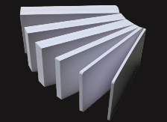

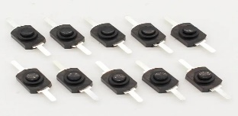
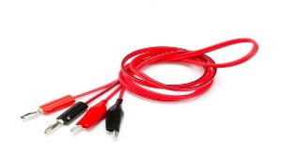
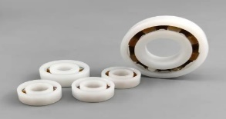
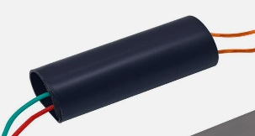
3. Practic Part
№ 6
№ 7
№ 8
№ 2
№ 3
№ 1

Slide 5
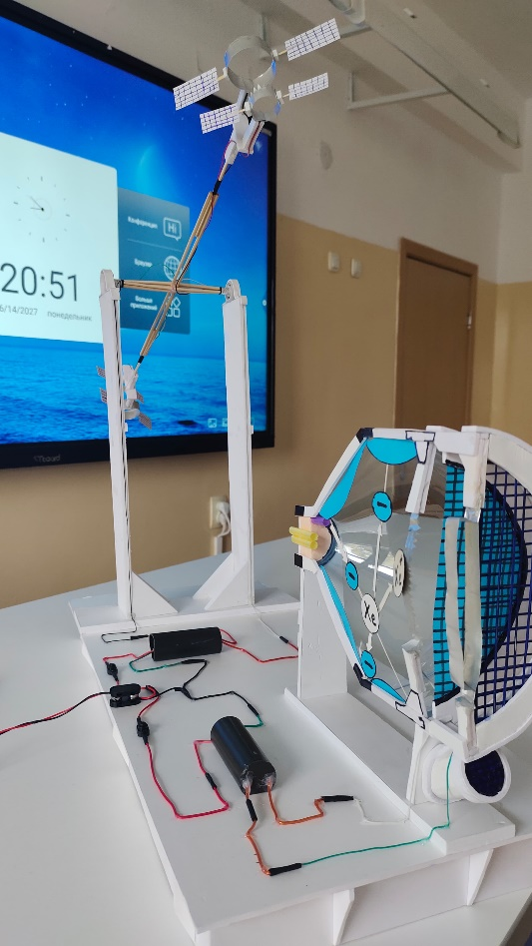
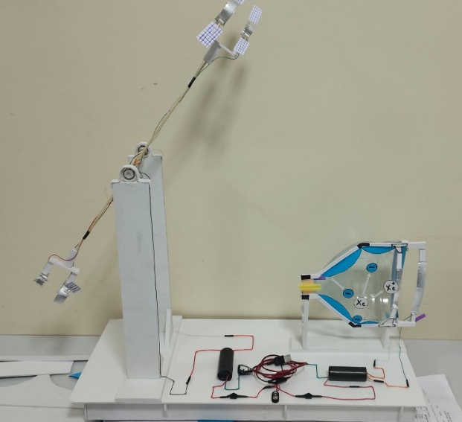
4. Practic Part
Stages for the complete completion of an ion engine model..

Slide 6
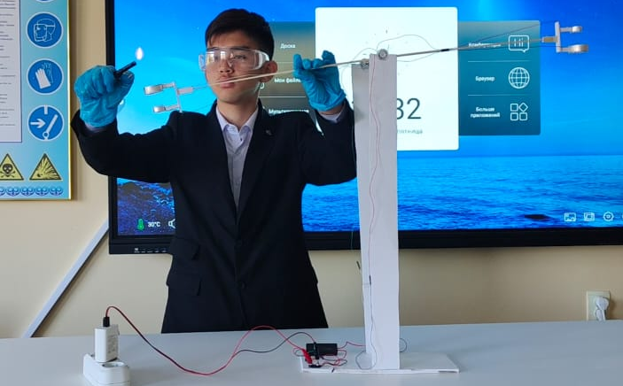
5. Practic Part
Ion engine model testing stages..
.

Slide 7
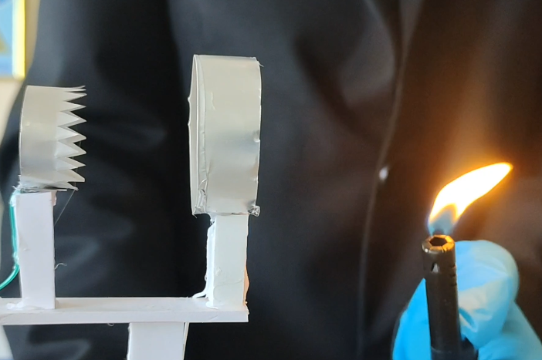
6. Practic Part
Stages of testing an ion engine model.

Slide 8
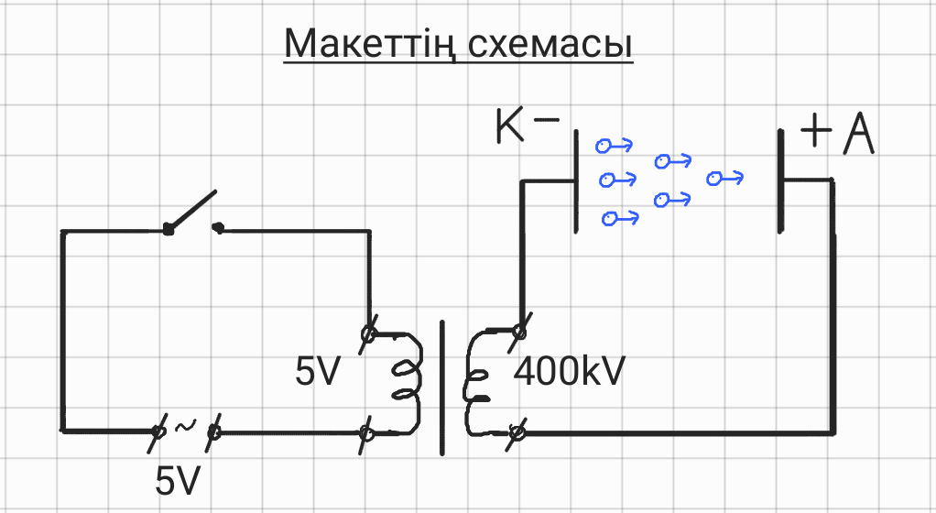
7. Practic Part
The model’s diagram is shown. As you can see in the given scheme, there is a 5-volt power source, then a switch, and in the middle there is a transformer. A 5-volt voltage is supplied to the transformer, and a 400,000-volt output is generated. The cathode is negatively charged, and the anode is positively charged. Due to the high voltage, electrons begin to fly from the cathode toward the anode. After these electrons are emitted, they carry along the surrounding air they encounter, creating an ionic wind.

Slide 9

8. Following safety rules
When building an ion engine model, the release of plasma and ozone gas, as well as working with a high-voltage power source, can be dangerous. Therefore, strict safety rules must be followed. Below is a list of safety measures to consider during this process:
1. Working with high-voltage power sources
When working with high voltage, wear dielectric protective gloves and rubber-soled shoes. This helps protect you from electric shock.
If you need to modify, inspect, or adjust the device, first turn off all power sources. Opening or changing the device while it is powered is very dangerous.
2. When plasma is generated
Work in a controlled and safe environment when plasma is produced. Ultraviolet radiation emitted by plasma can be harmful to the eyes. Therefore, avoid looking directly at the device or use protective goggles.
3. Ozone gas release
Ventilation system: Ozone gas may be released during plasma generation. Inhaling large amounts of ozone is harmful, so the room must be well ventilated or an air purification system should be used.
Protective mask: If ventilation is insufficient, use a respirator or special protective mask to avoid ozone exposure.

Slide 10
8. Conclusion
The ion engine is an innovative achievement in space technology. Its main feature is the ability to achieve high speeds in space using minimal fuel. Compared to chemical engines, ion engines are much more efficient and are suitable for long-distance missions and space exploration. The ion engine model we built is an important tool for understanding the working principles of this technology. It demonstrates the processes of ionization, acceleration, and motion, helping students understand complex physical mechanisms. The project is aimed not only at theoretical learning but also at developing practical skills.
By thoroughly studying the working principles of ion engines, information was collected and analyzed from scientific sources. During the work process, a working model of an ion engine was constructed, and its results were carefully tested. The obtained data proved useful for use in physics lessons and extracurricular activities. This research opened the way to a broader understanding of ion engine capabilities and their practical application.
While building the model, students learn different aspects of engineering and develop technical skills. This is not only a lesson but also a strong motivational tool that sparks interest in science and space. Students gain practical experience in engineering alongside theoretical knowledge, preparing them for more complex projects in the future. The economic efficiency of the project is also important: building the ion engine model costs about 2000 tenge, making it affordable for any student. In conclusion, this model helps develop engineering skills and serves as a first step toward space research.

